Slide 1
Introduction to OpenCL 2.0
Jeng Bai-Cheng
Engineer
Computing Platform Technology Division in CTO
MediaTek, Inc.
Bai-Cheng.Jeng@mediatek.com
May 4, 2015 – NTHU, HsinChu

Slide 2
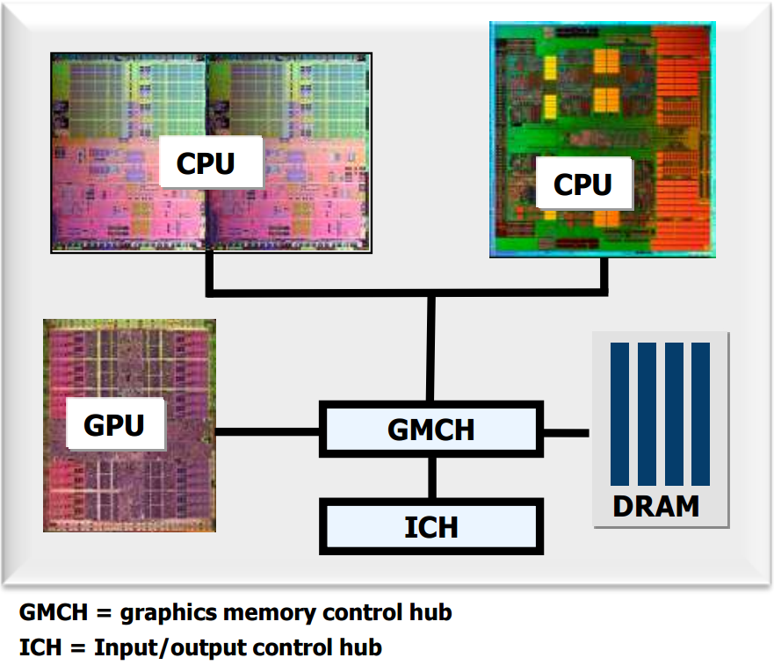
Background
It’s a Heterogeneous World today
A modern platform includes:
  One or more CPUs
  One or more GPUs
  Optional accelerators (e.g., DSPs)

Slide 3
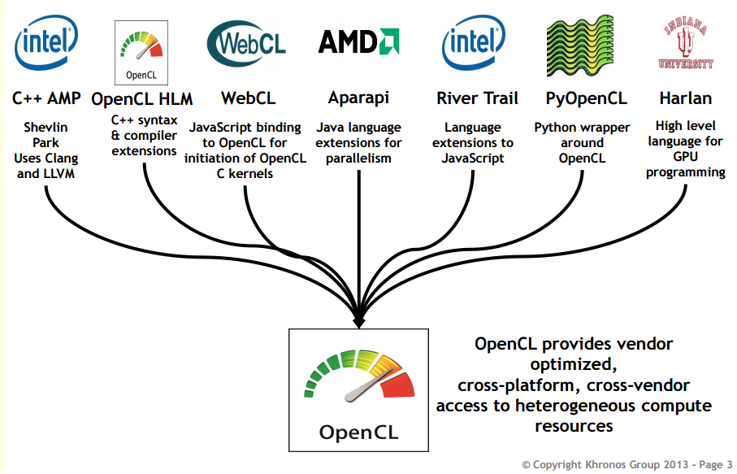
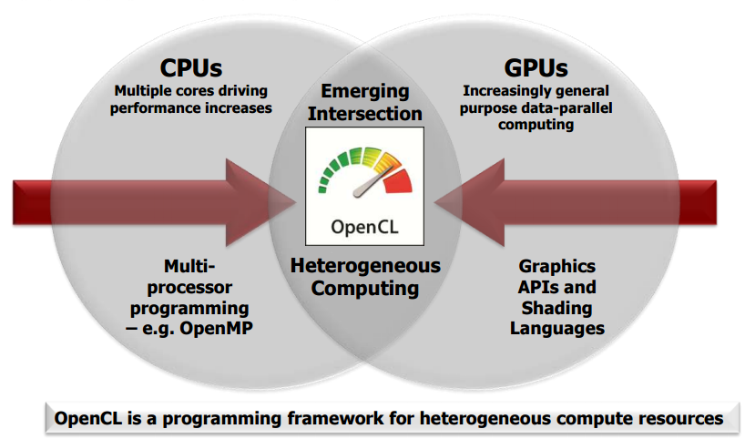
What is OpenCL?

Slide 4
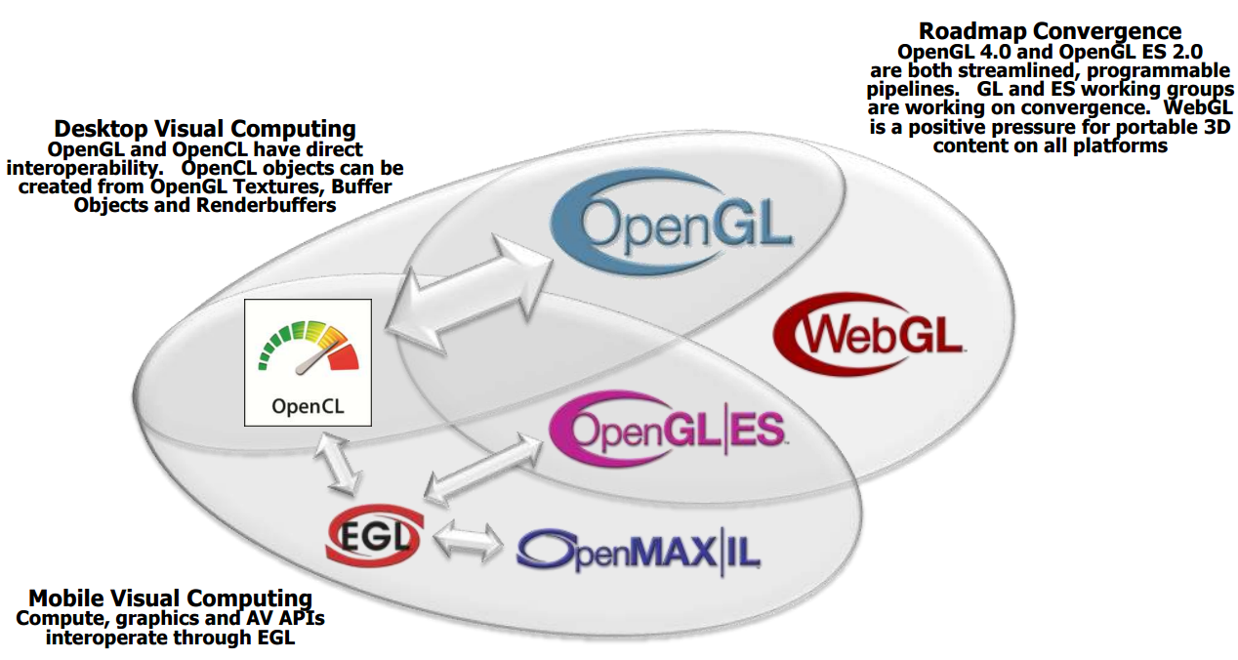
OpenGL-based Ecosystem

Slide 5
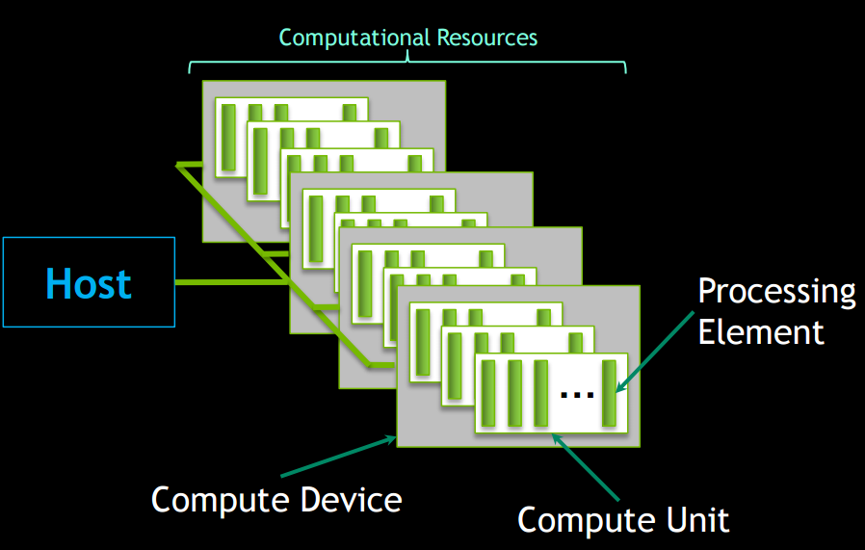
OpenCL Platform Model

Slide 6
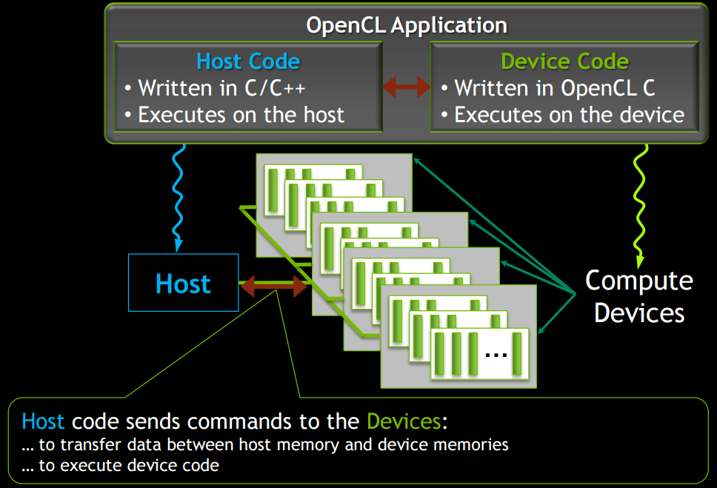
OpenCL Execution Model

Slide 7
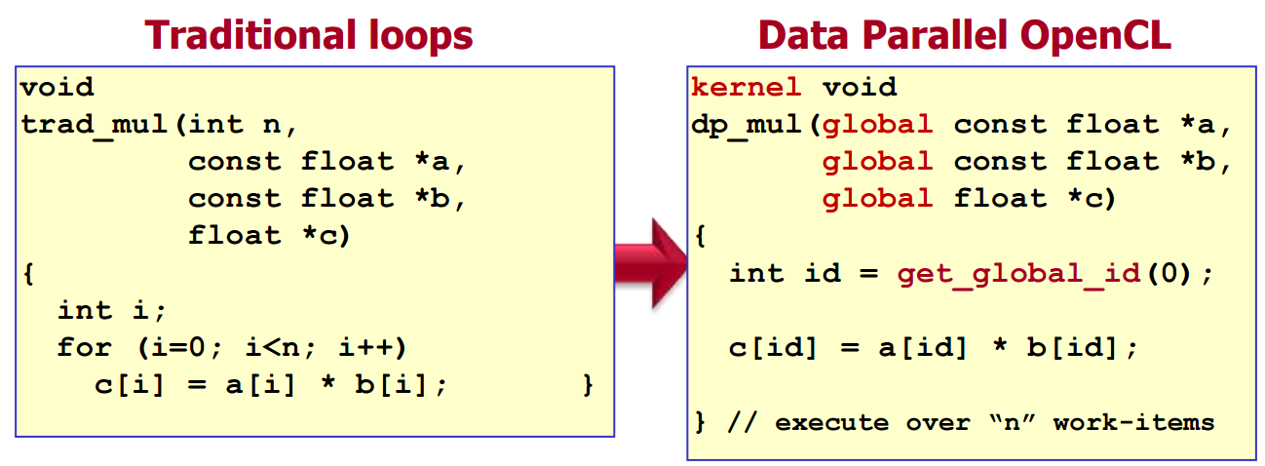
Decompose task into work-items
Define N-dimensional computation domain
Execute a kernel at each point in computation domain

Slide 8
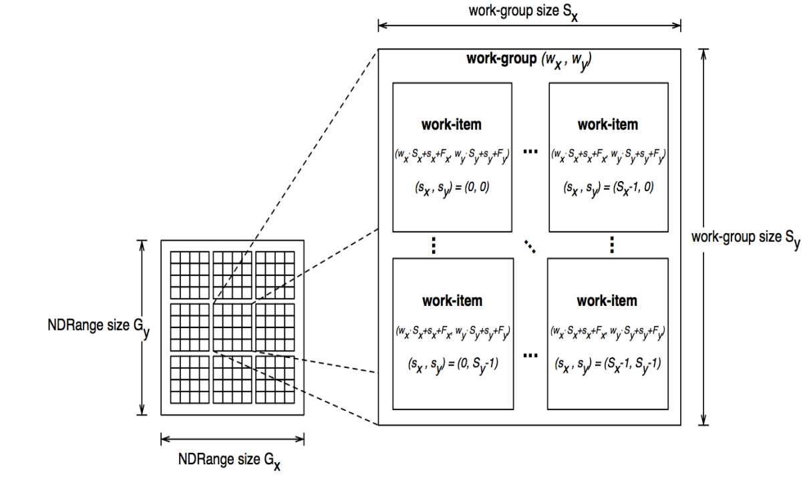
An N-dimension domain of work-items
Define the N-dimensioned index space for your algorithm
  Kernels are executed across a global domain of work-items
  Work-items are grouped into local work-groups

Slide 9
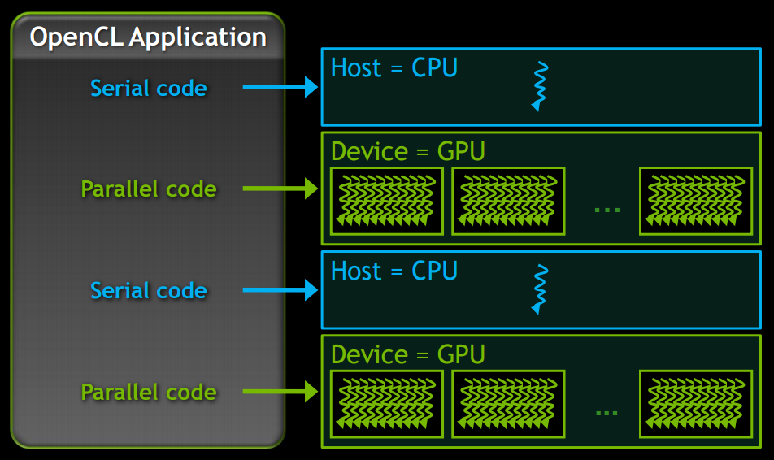
Anatomy of an OpenCL Application
Serial code executes in a Host (CPU) thread
Parallel code executes in many Device (GPU) threads across multiple processing elements

Slide 10
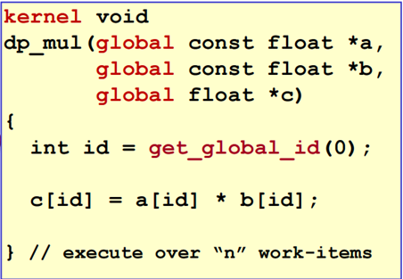
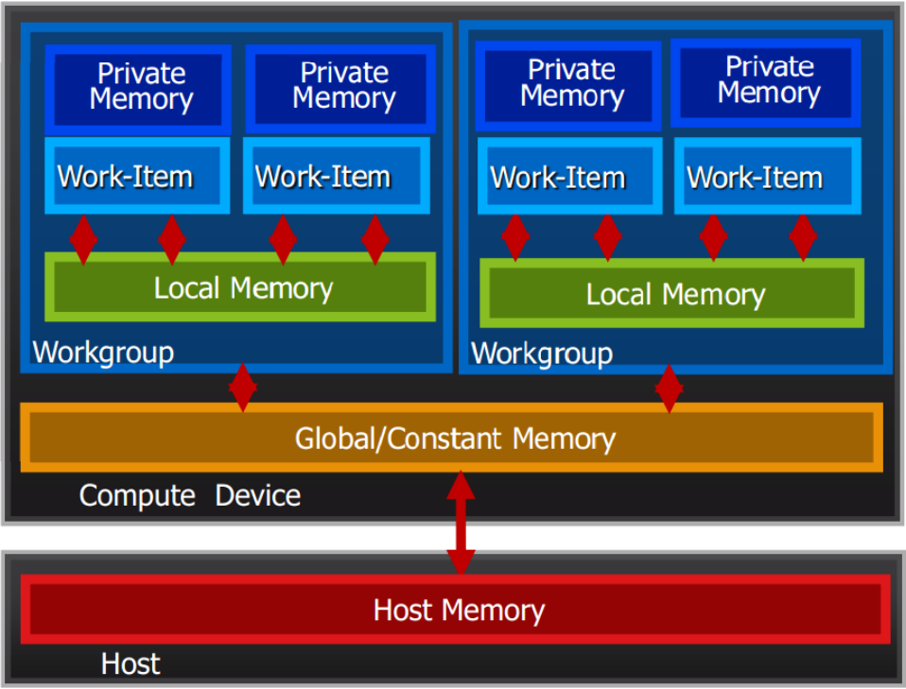
OpenCL memory hierarchy

Slide 11
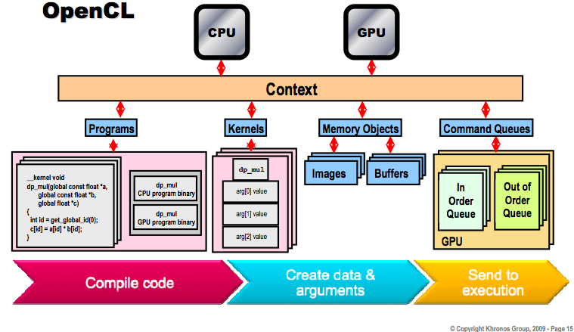
Big Picture

Slide 12
OpenCL 2.0 New Features

Slide 13
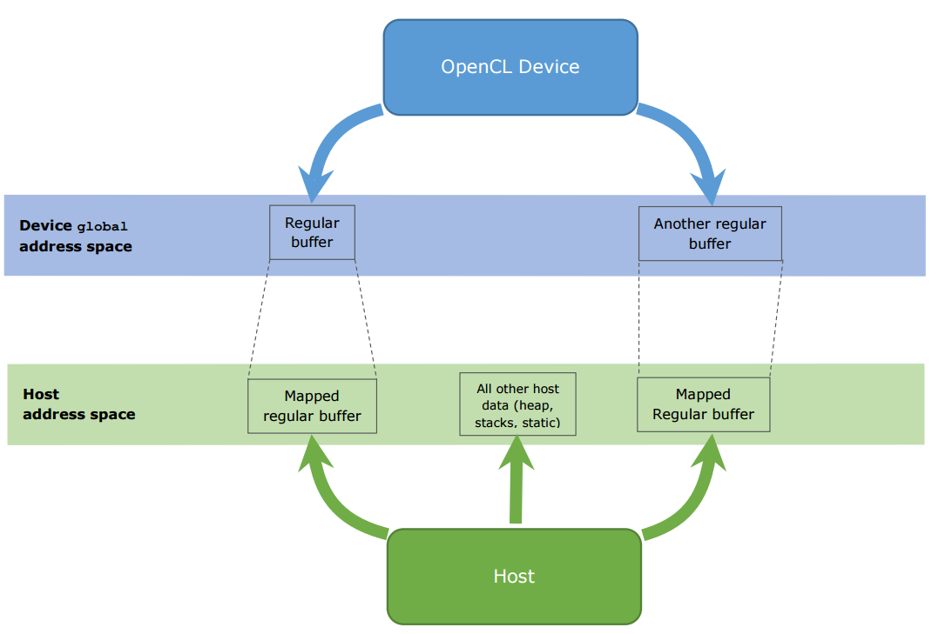
Shared Virtual Memory
Before OpenCL 2.0
  Doesn’t provide any guarantees that a pointer assigned on the host side can be used to access data in device side
  Data with pointers cannot be shared between the sides, and the application should be designed accordingly, for example, with indices used instead of pointers
■ Device address space
■ Host address space

Slide 14
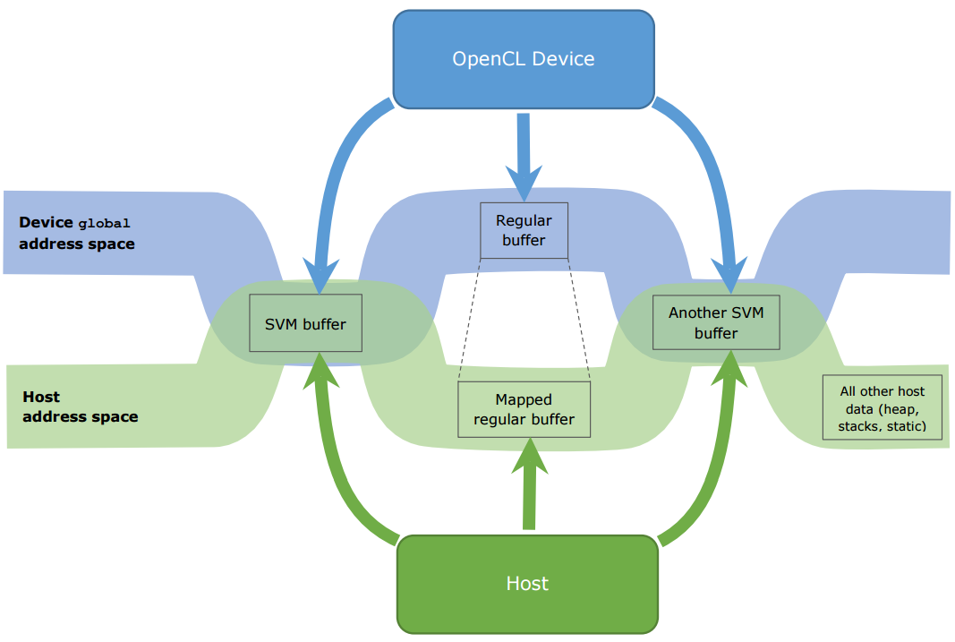
Shared Virtual Memory
After OpenCL 2.0
  Enables the host and device portions to seamlessly share pointers and complex pointer-containing data-structures
Benefits
  Host-allocated buffers are directly accessible by devices.
  Host and devices can refer to the same memory locations using the pointer values.
  Reduce data movements between host and devices.
■ Device address space
■ Host address space

Slide 15
Category of SVM
SVM Feature | SVM Type
 | Coarse-grained buffer | Fine-grained buffer |  | Fine-grained system
 |  | w/o atomics | with atomics | w/o atomics | with atomics
Shared virtual address space | ● | ● | ● | ● | ●
Fine-grained coherent access (cache coherent) |  | ● | ● | ● | ●
Fine-grained synchronization |  |  | ● |  | ●
Sharing the entire host address space |  |  |  | ● | ●
Non-coherent
Coherent
Coarse-grained buffer is core feature
The other are optional feature
MMU & OS

Slide 16


C11 Atomics Support
Core feature
Before OpenCL 2.0
  OpenCL 1.2 implements atomic operations using built-ins
After OpenCL 2.0
  mainly aim to achieve compatibility with C++11 standard
  control atomic operation memory synchronization ordering and scope
    order: relaxed, acquire, release, acq_rel, seq_cst
    scope: work_group, device, all_svm_devices

Slide 17
C11 Atomics Support
Benefits:
  The work-group scope generally provides more optimization opportunities for the compiler
  Platform coherency provides coherent accesses to the shared memory locations across host and devices.
  An efficient way to coordinate between host and devices, e.g. when both can dispatch kernels to a task queue.

Slide 18
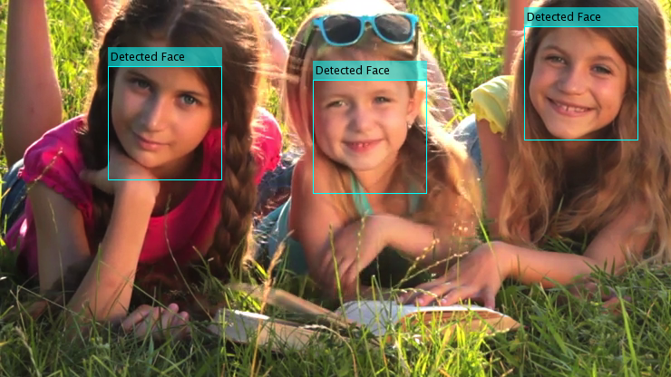
SVM example
User launches the demo application
  Application immediately starts playing back a 1 minute looping video clip
  Face detection runs on GPU
    Faces are identified on-screen with a blue rectangle
  Face recognition runs on CPU
    Faces are tagged with the person’s name
Courtney
Anna
Britney

Slide 19
Without SVM:
Latency for Face 3
CPU:
Input
Image
Kernel launch
Recognize Face 1
Recognize Face 2
Recognize Face 3
GPU:
Detect Faces
Kernel completed
With Fine-grained buffer:
Kernel launch
Latency for Face 3
Callback
Callback
Callback
CPU:
Input
Image
Recognize Face 1
Recognize Face 2
Recognize Face 3
GPU:
Detect Faces
time

Slide 20


Generic Address Space
Core feature
Before OpenCL 2.0
  programmer had to specify an address space of what a pointer points to when that pointer was declared or the pointer was passed as an argument to a function.
After OpenCL 2.0
  the pointer itself remains in the private address space, but what the pointer points has changed its default to be generic meaning it can point to any of the named address spaces within the generic address space.

Slide 21
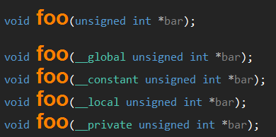
Generic Address Space
Benefits
  Makes it really easy to write functions without having to worry about which address space arguments point to
  To allow a single pointer to join different memory segments reached from different control flow paths.
  Simplify compiler implementation
    Reduce the number of function entries to serve arguments with different memory segments
Notes:
SW requirements
Compilers
Implicit and explicit casting rules btw named and generic address space
New built-in functions, e.g. is_global(), is_local, cl_mem_fence_flags get_fence()
Driver
Conversions btw segmented and flat addressing

Slide 22
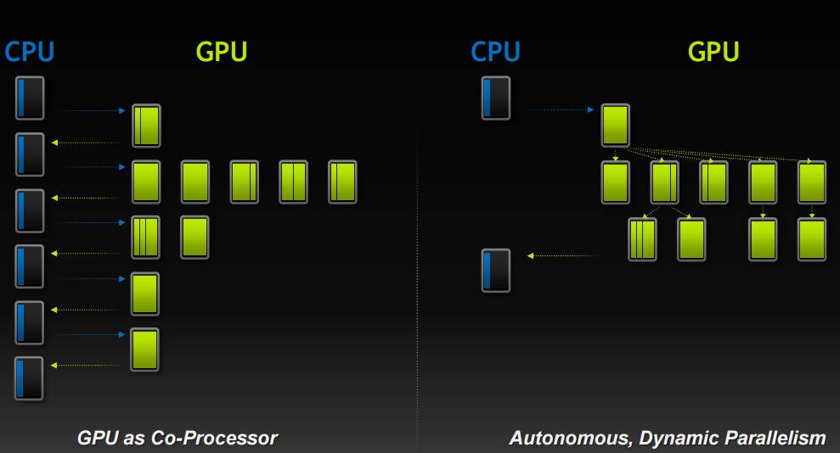
Nested Parallelism
Core feature
The ability to launch new tasks from the device

Slide 23
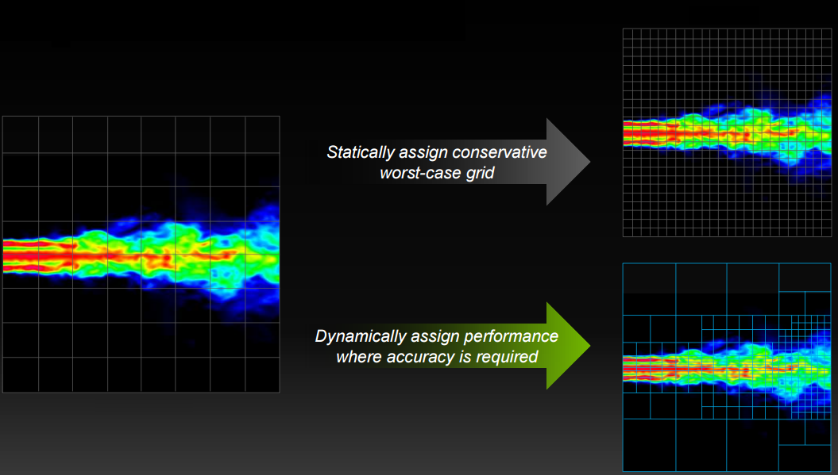
Nested Parallelism with Data-Dependent Parallelism
Computational Power allocated to regions of interest
Benefits:
  Allow kernel to dispatch new kernels
  without having to go back to host. Reduce overheads.
  Fit for nested or
  recursive algorithms
(traditional)
(Nested Parallelism)

Slide 24

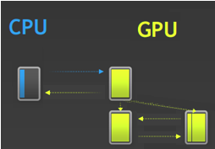
Pipe
Core feature
new mechanism for passing data(packets) between kernels
Before OpenCL 2.0
  Data transmission only between host and devices
After OpenCL 2.0
  Data transmission can be inner of devices

Slide 25
Pipe
Benefits:
  Enable producer – consumer relationships, like inter-process communication
  combine pipes with the Nested Parallelism feature in OpenCL 2.0 to dynamically construct computational data flow graphs

Slide 26
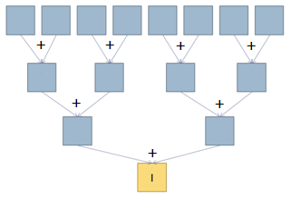
Work-group Functions
Core feature
The built-ins provide popular parallel primitives that operate at the workgroup level
  value broadcast, reduce, and scan
  Reduce and scan algorithms support add, min and max operations
Reduce with add ops

Slide 27
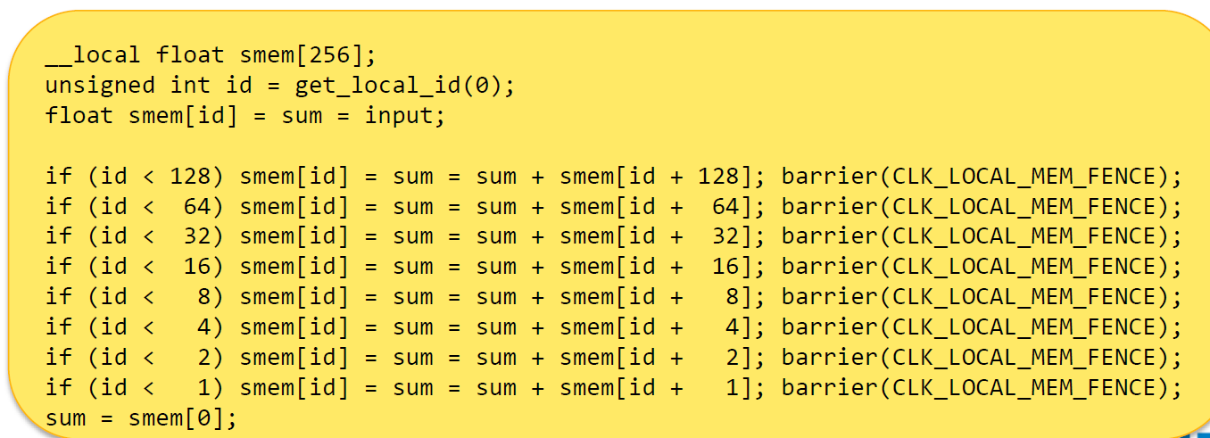
Work-group Functions example
Benefits
  work-group functions are convenient
  more performance efficient, as they use
  hardware-specific optimizations internally
(traditional)
(with OpenCL 2.0)

Slide 28
OpenCL 2.0 sample

Slide 29
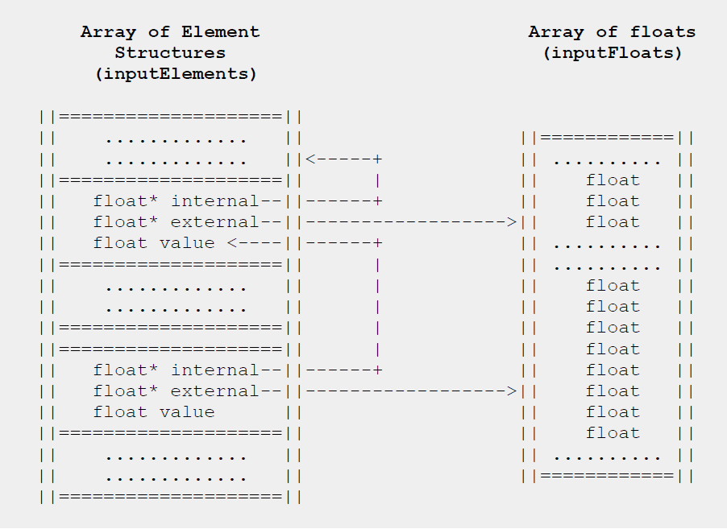
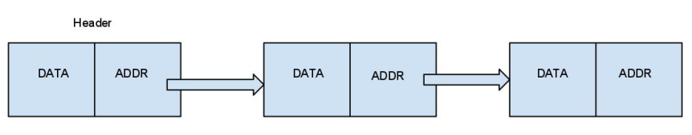
Linked list with SVM
In both Linked list samples with SVM of Intel and AMD, it only use pointers pointed to an array, not really linked list.
We wonder what happen if we implement a traditional linked list with SVM
workitem 0
workitem 1
workitem 2
Just give the pointer of header to GPU
Each workitem takes a node in parallel

Slide 30
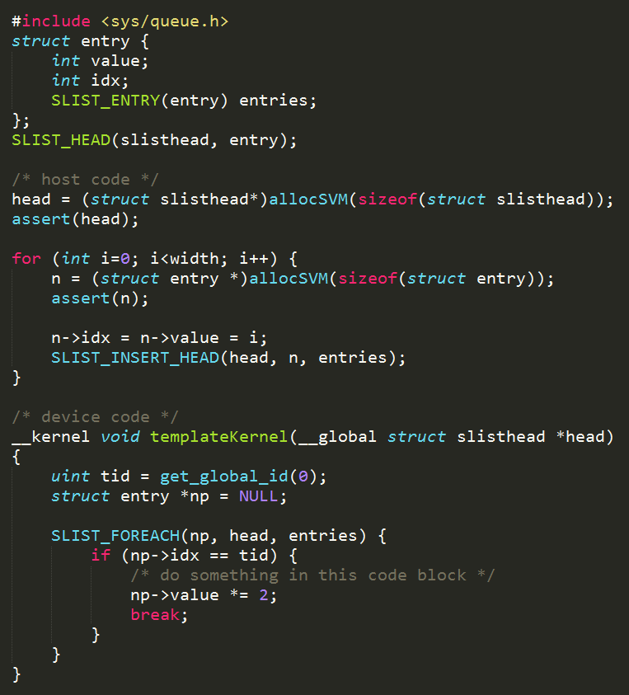
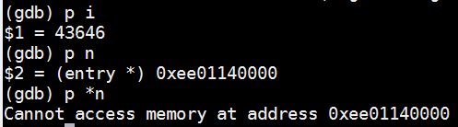
The implementation of Linked list with SVM
Yes, we can use traditional linked list with AMD OpenCL SDK 3.0 beta
Input: 0->1->2->3…
Output: 0->2->4->6…
However, there is strange bug. It only can create 43645 nodes

Slide 31
Performance of Linked list with SVM

Slide 32
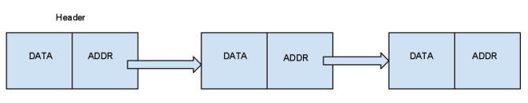
More info. of linked list with SVM
Address:
  0xec00000000 // header
  0xec00010000 // first node
  0xec00020000
  ...
  0xecaa7c0000
  0xecaa7d0000
  0xee01140000
Size of page: 64 KB
Max. size of SVM buffer: 2.4 GB~
workitem 0
workitem 1
workitem 2
Just give the pointer of header to GPU
Each workitem takes a node in parallel

Slide 33
Parallel Binary search
Parallel binary search
  divide the array into segments
  Each workitem takes 1 segment
  Find the segment to which the key belongs and further divide the segment
  If key is between the lower-bound and upper-bound of segment 0, only workitem 0 writes to the output buffer
workitem 0
workitem 1
workitem 2
A_{0………………} A_{n}
A_{n+1………………} A_{2n}
A_{2n+1………………} A_{3n}

Slide 34
Parallel Binary search
According output, we narrow our search space by subdividing the array, then go to the next pass
workitem 0
workitem 1
workitem 2
A_{0………………} A_{n}
A_{n+1………………} A_{2n}
A_{2n+1………………} A_{3n}
workitem 0
workitem 1
workitem 2
A_{0………………} A_{m}
A_{m+1………………} A_{2m}
A_{n-m………………} A_{n}

Slide 35
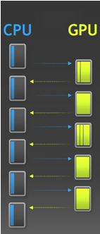
Binary search without Device Enqueue
In AMD OpenCL 1.x test-case
  Host have to read the output to decide that which segments should be input and how many workitem should be dispatched for the next pass
  Busy communication between host and devices

Slide 36
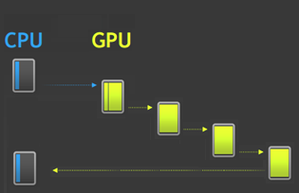
Binary Search with Device Enqueue
With OpenCL 2.0
  Recursively enqueue kernel by itself until find the key or sub-segment can not be divided any more

Slide 37
Performance of Binary search
We can expect device enqueue can improve the performance of this algorithm.
However there is bug of AMD’s implementation for OpenCL 1.x test-case. It only enqueue kernel 1 times, then let CPU finish remaining jobs

Slide 38
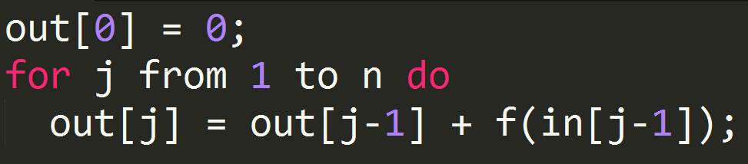
Prefix Sum
Input: [a ₀, a ₁,..., a _{n–1}]
Output: [a ₀, (a ₀ + a ₁),..., (a ₀ + a ₁ + ... + a _{n–2})]
Example:
  Input: [3 1 7 0 4 1 6 3]
  Output: [3 4 11 11 15 16 22]
Sequential algorithm: O(n)

Slide 39
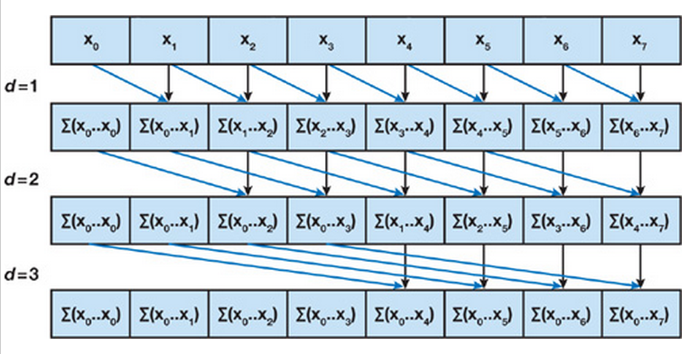
Parallel Prefix Sum
Simple version

Slide 40
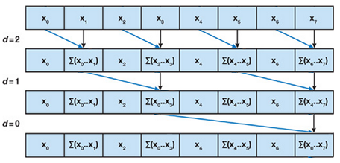
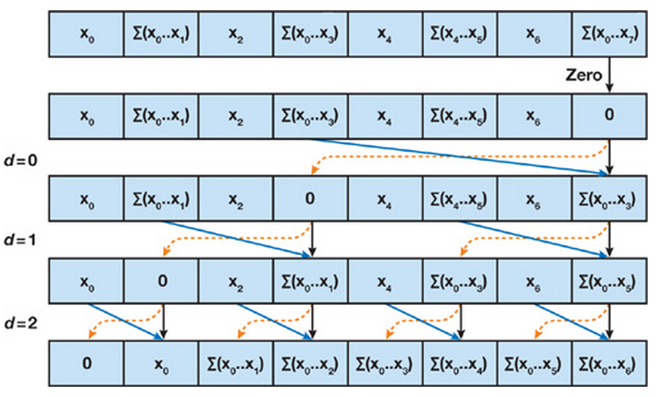
Parallel Prefix Sum
Work-Efficient version (Blelloch 1990)
Step 1. The Up-Sweep: O(n)
Step 2. The Down-Sweep: O(n)

Slide 41
Parallel Prefix Sum with OpenCL
Local prefix sum
  Use shared local memory and barrier to implement local prefix sum
Global prefix sum
  merge results of each local prefix sum
workgroup 0
workgroup 1
workgroup 2
[3 4 11 11 15 16 22]
[4 9 18 19 22 24 24]
[3 8 15 15 17 21 27]
workgroup 0
workgroup 1
workgroup 2
[3 4 11 11 15 16 22]
[26 31 40 41 44 46 46 ]
[49 54 61 61 63 67 73 ]

Slide 42
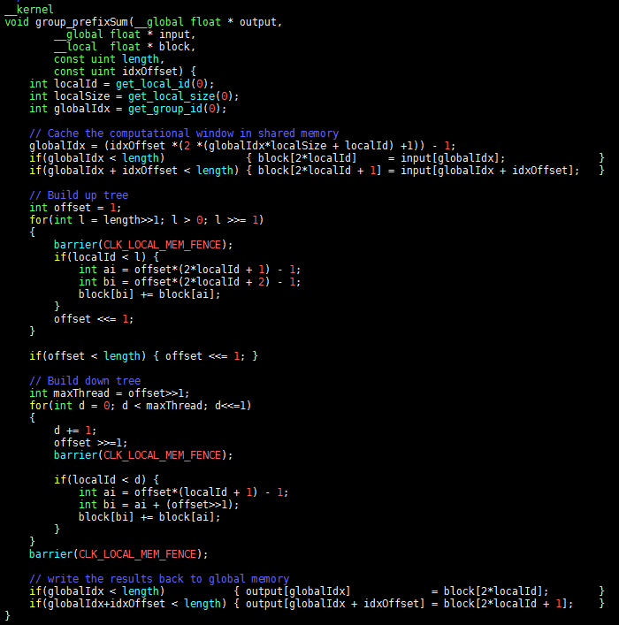
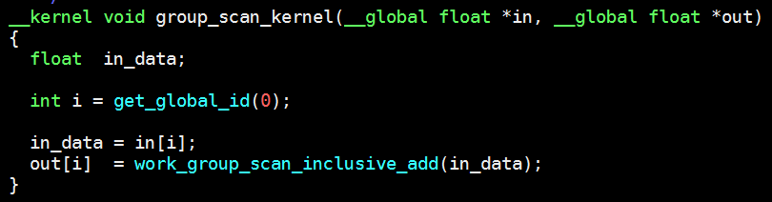
Local Prefix Sum with Workgroup Function
Without workgroup function
With workgroup function

Slide 43
Global prefix sum
Local prefix sum →
Global prefix sum ↓
workgroup 0
workgroup 1
workgroup 2
[3 4 11 11 15 16 22]
[4 9 18 19 22 24 24]
[3 8 15 15 17 21 27]
workgroup 0
workgroup 1
workgroup 2
[3 4 11 11 15 16 22]
[26 31 40 41 44 46 46 ]
[27 32 39 39 41 45 51 ]
workgroup 0
workgroup 1
workgroup 2
[3 4 11 11 15 16 22]
[26 31 40 41 44 46 46 ]
[49 54 61 61 63 67 73 ]

Slide 44
Performance of Prefix Sum
Compare 2 implementations of prefix sum in the AMD SDK
In the small size of data, workgroup function provide better performance
When size of data > 512K, it has the performance drop caused by global prefix sum, the implementation is simple parallel prefix sum

Slide 45
Issue of Global Prefix Sum
The implementaion of prefix sum with workgroup function, non-work efficient
workgroup 0
workgroup 1
workgroup 2
[3 4 11 11 15 16 22]
[4 9 18 19 22 24 24]
[3 8 15 15 17 21 27]
workgroup 0
workgroup 1
workgroup 2
[3 4 11 11 15 16 22]
[26 31 40 41 44 46 46 ]
[27 32 39 39 41 45 51 ]
workgroup 0
workgroup 1
workgroup 2
[3 4 11 11 15 16 22]
[26 31 40 41 44 46 46 ]
[49 54 61 61 63 67 73 ]
The implementation of prefix sum without workgroup function
workgroup 0
workgroup 1
workgroup 2
[3 4 11 11 15 16 22]
[4 9 18 19 22 24 24]
[3 8 15 15 17 21 27]
[0 22 46]
workgroup 0
workgroup 1
workgroup 2
[3 4 11 11 15 16 22]
[26 31 40 41 44 46 46 ]
[49 54 61 61 63 67 73 ]

Slide 46
More info. of local prefix sum
In order to measures the performance of workgroup function, remove the global prefix sum
Input: [a ₀, a ₁,..., a _{n–1}]
Output: [a ₀, (a ₀ + a ₁),..., (a ₀ + a ₁ + ... + a _{n–2})]
Example:
  Input: [3 1 7 0 4 1 6 3]
  Output: [3 4 11 11 15 16 22]
log₂(time)

Slide 47
Conclusion
OpenCL is the most popular open programming standard for heterogeneous computing.
OpenCL 2.0 is a big step forward with key features on execution and memory models.
OpenCl 2.0 is a key driving force to our heterogeneous computing HW and SW technology.

